Slide 1
GOOGLE ONLINE MARKETING CHALLENGE
Ayesha Chacko
Reshmi Krishna
Alice Lee

Slide 2


ADWORDS
Advertisers set maximum Price-per-Click (PPC), either Cost-per-Click of Cost-per-thousand impressions (CPM)
Ad Rank = CPC x Quality Score
Quality Score: Historical CTR, relevance, advertiser’s account history, many other relevant factors

Slide 3
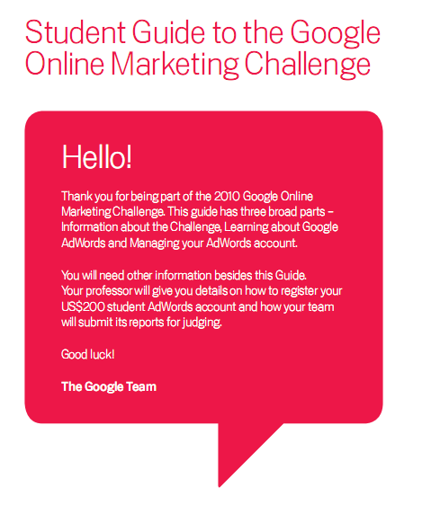
ABOUT THE CHALLENGE
Student teams receive $200 for three consecutive weeks of advertising
Assess results, give recommendations to business

Slide 4
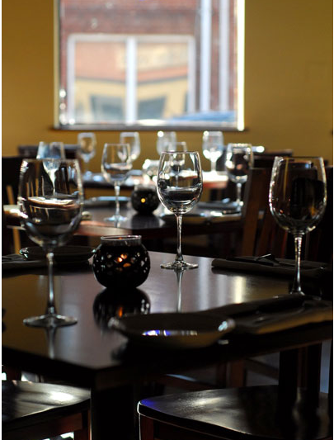
WHY HORIZONS
Small business, <20 employees
Star in a niche market
Little history of advertising
People may be willing to travel to eat there, are looking for a place to eat when they search for a vegetarian restaurant, e.g.

Slide 5
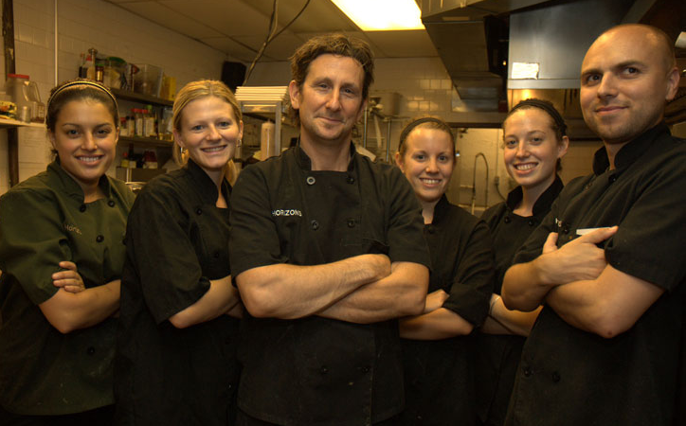
CLIENT PROFILE
Reaches out to vegetarians and pushes the envelope in sophisticated cuisine
  Accommodating to diets and allergies
Supportive and loyal customer base
History

Slide 6
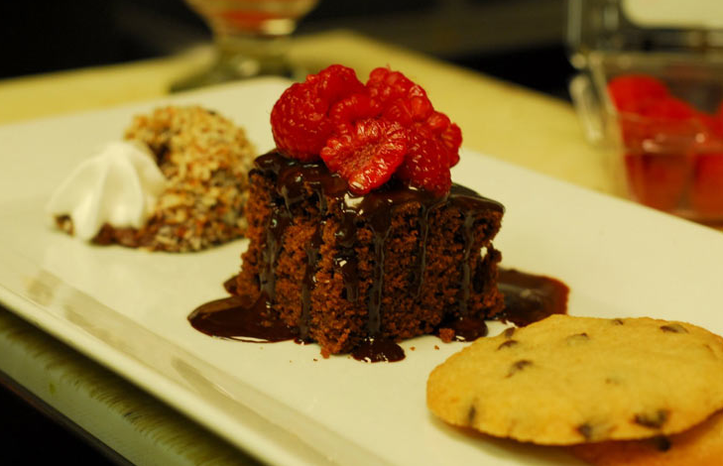
CLIENT PROFILE (II)
Company presence and sales via online and offline channels
Customers: About 65% are vegetarian
  10% of those are strict vegans

Slide 7
MARKET ANALYSIS
Current and potential customers
  Older, health-conscious crowd and young adventurous couples
Vegetarians in Philadelphia: large and active, more casual
Overview of the industry
  Competition
  Trends
Other relevant market information

Slide 8
CURRENT MARKETING
Website strengths and weaknesses
Website visibility
  Page rank: 5/10

Slide 9
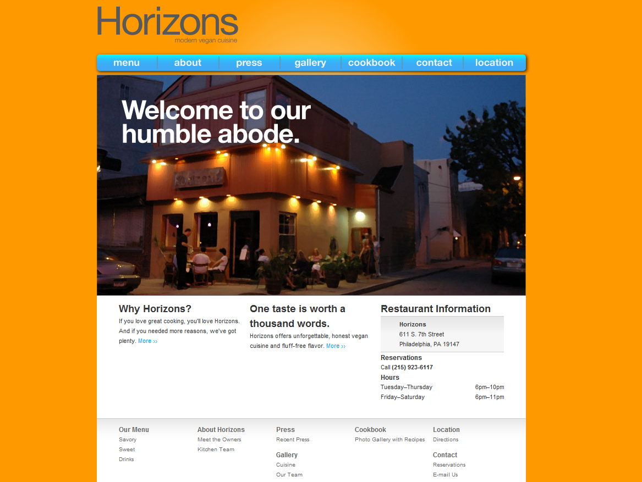

Slide 10
CURRENT MARKETING (II)
Current use of Google Analytics
  Number of viewers
  Incoming/outgoing links
  Goal setting
Promotions – New Years, Valentines Day, Mothers Day, James Beard House

Slide 11
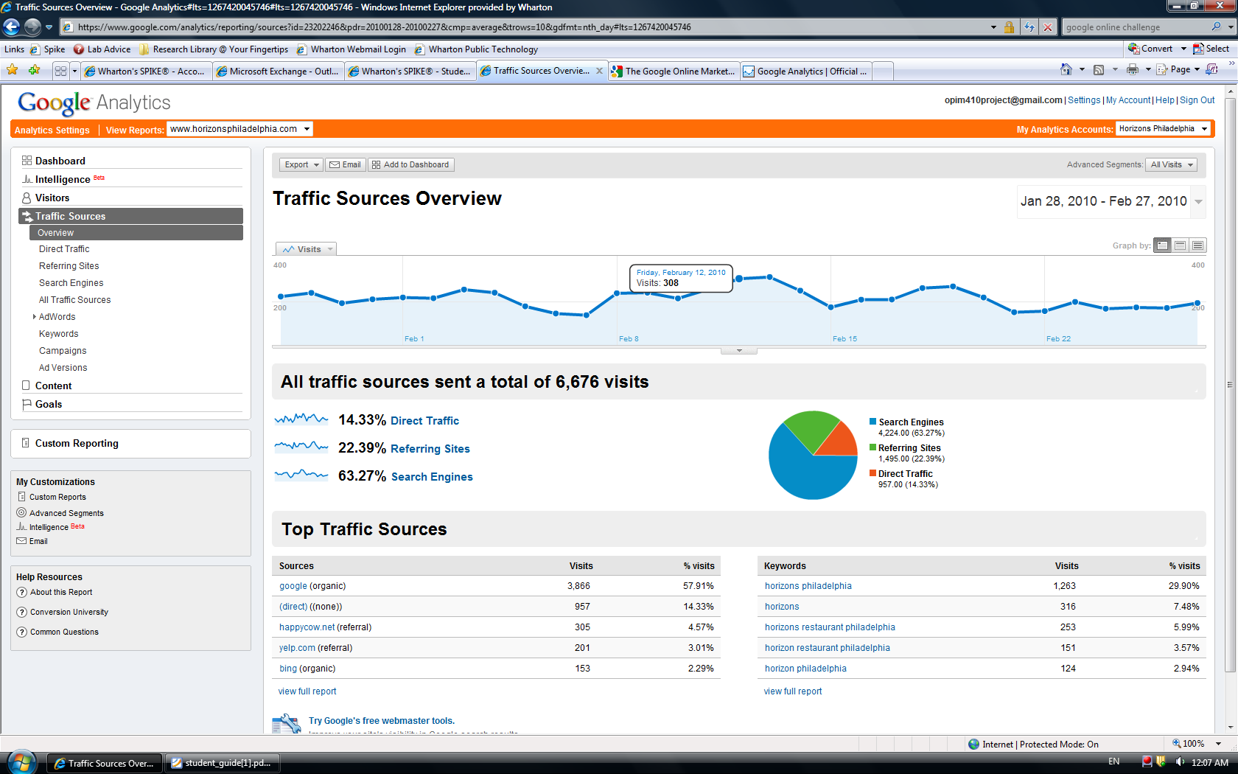
GOOGLE ANALYTICS
Anything it provides…

Slide 12
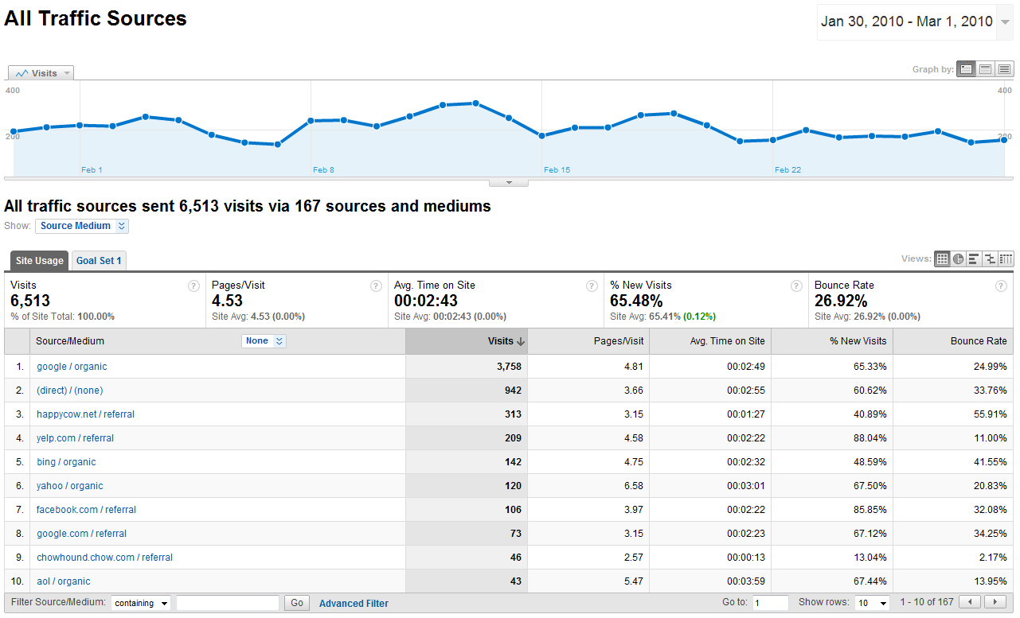
GOALS
Goal: Expand customer base
How to assess: change in the Click-Through Rates (CTRs) for brand-neutral queries

Slide 13
QUALITIES OF A GOOD CAMPAIGN
Fits within a budget ($200 in our case)
Collects informative, sufficient data
Profitable keywords (low cost-per-click, high CTR)

Slide 14
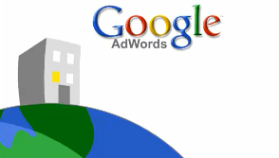
HOW TO OPTIMIZE OUR CAMPAIGN
Predicting Ad Rank. Predicts ads that will be successful based on data from other campaigns.
Choosing Keywords. Have fewer, more profitable keywords to cut costs and maximize returns.

Slide 15
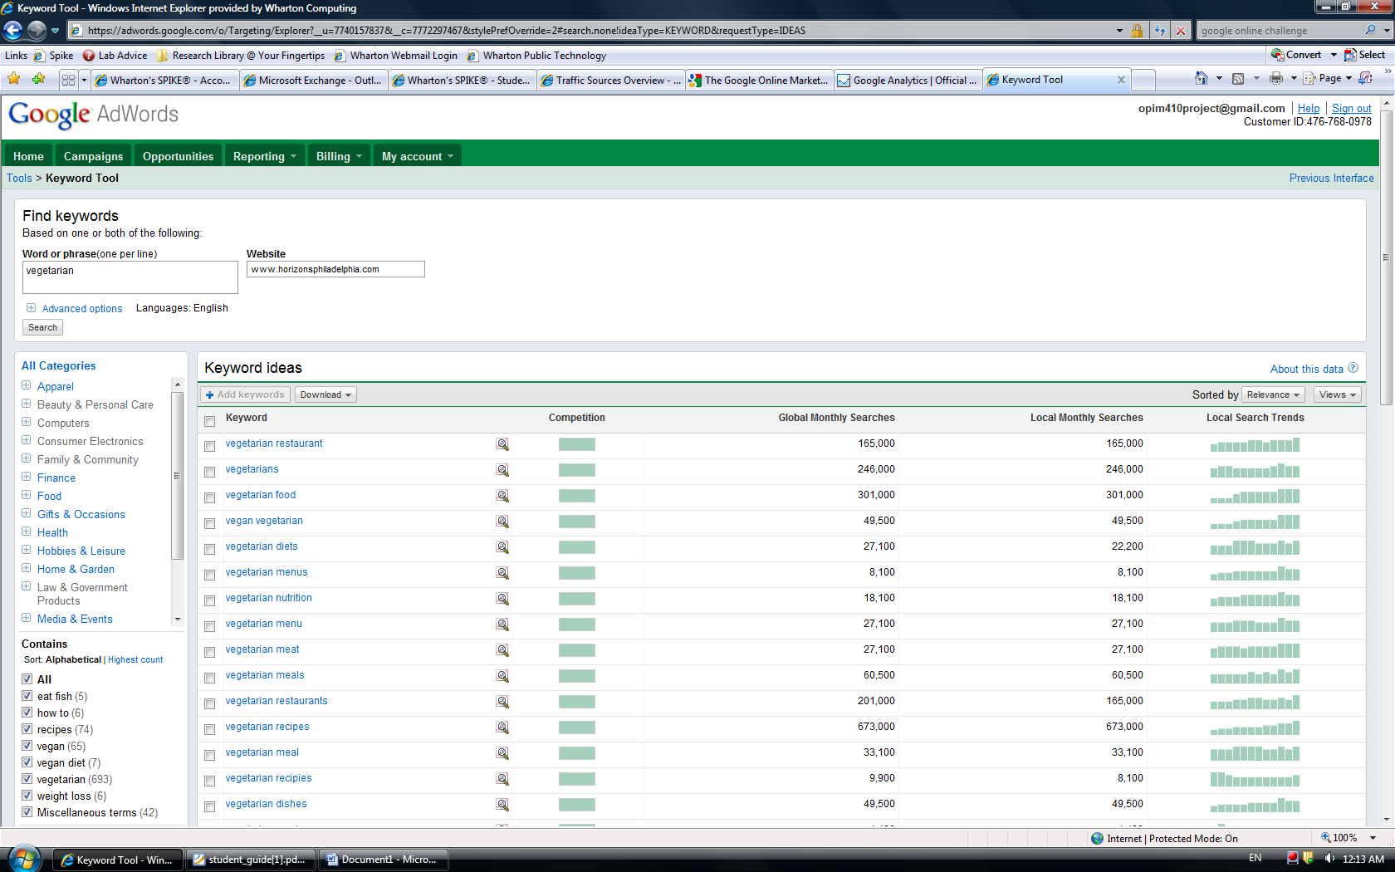
SOME RELEVANT DATA

Slide 16
1. PREDICTING AD RANK
Use script to find keywords that appear often in top-ranked ads
Write ads for Horizons
Predict which will do best

Slide 17
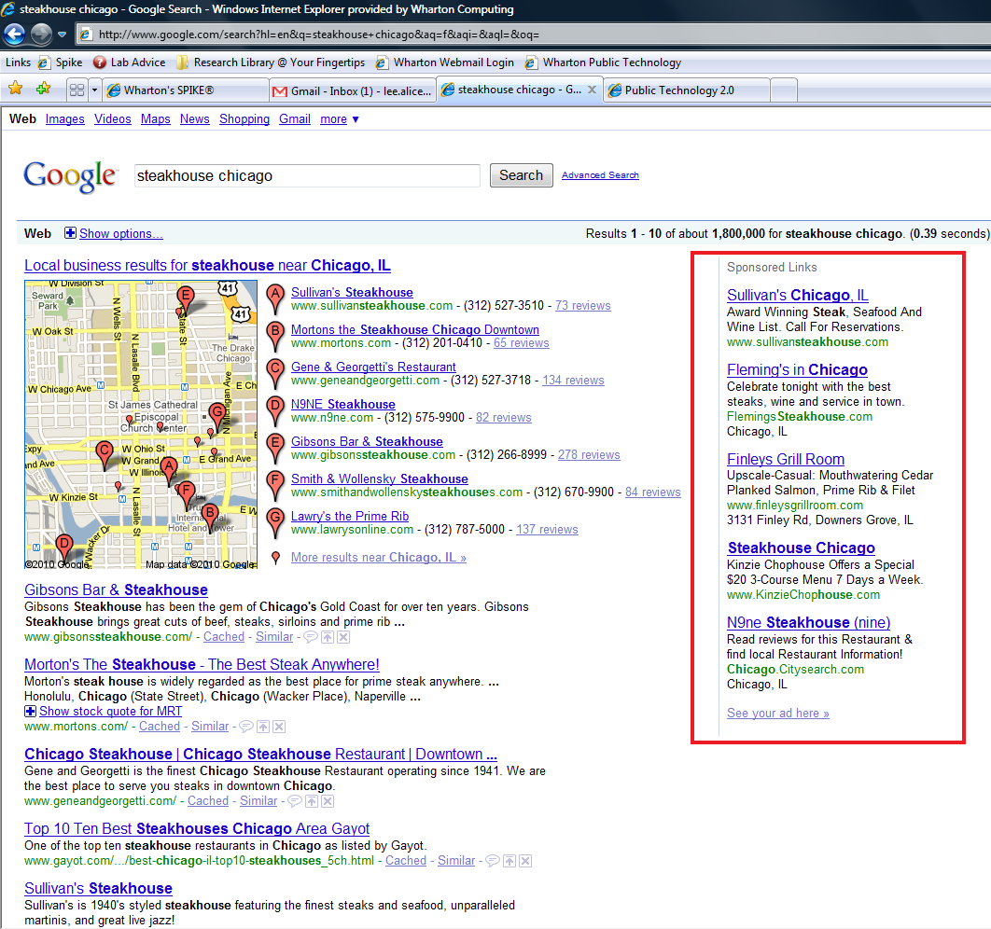

Slide 18
2. CUTTING KEYWORDS
Goal: Minimize CPC/CTR for non-branded keywords
Run ~10 keywords for four days
Calculate CPC/CTR for each keyword
Pick the best 4-5

Slide 19
MOVING FORWARD
Write web crawler that will download comprehensive ad information (title, body, rank on page)
Overall goal: Maximize ROI and conversion rates of AdWords

Slide 20
QUESTIONS?

